Slide 1
Web Services

Slide 2
Web Service
A system resides on a Web Server for serving client specific needs
Can perform calculations, serves utilities or expose data
There are many techniques, architectures and technologies to create a Web Service:
XML Web Services
Remote Procedure Calls (RPCs)
Windows Communication Foundation (WCF)
REST APIs
and more…

Slide 3
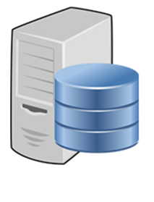
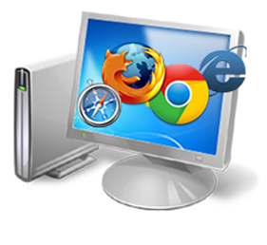


Weather Station, without using a Web Service
Frontend Browsers
Surfs the Weather Station’s website and watch the weather
Weather Station Website
Read weather data from a DB and displays it in their website

Slide 4
Weather Station, using a Web Service
Frontend Browsers
Surfs the Weather Station’s website and watch the weather
Weather Station Website
Consumes the weather data from the Web Service and displays it in their website
Weather Station Web Service
Read weather data from a DB and expose it to the world

Slide 5
Weather Station, using a Web Service
Frontend Browsers
Surfs the News Portal’s website and watch the weather
News Portal Website
Consumes the weather data from the Web Service and displays it in their website
Weather Station Web Service
Read weather data from a DB and expose it to the world

Slide 6

Weather Station, using a Web Service
Weather Mobile Apps
Consumes the weather data from the Web Service and displays it in the apps
Weather Station Web Service
Read weather data from a DB and expose it to the world

Slide 7

Weather Station, using a Web Service
Frontend Browsers / Apps
Consumes the Sea Research data and displays it in their websites / apps
Sea Research Web Service
Consumes the weather data from the Web Service and use it in their own exposed data
Weather Station Web Service
Read weather data from a DB and expose it to the world

